Slide 1
2016 Amendment to the Collocation Agreement for DAS and Small Cells
Paul D’Ari
Senior Counsel
Competition and Infrastructure Policy Division
Paul.Dari@fcc.gov

Slide 2
First Amendment to Collocation Agreement
The original Nationwide Programmatic Agreement for the Collocation of Wireless Antennas was entered into by the FCC, Advisory Council, and NCSHPO on March 16, 2001.
Applies to review of collocations of wireless antennas on existing towers, buildings, and other structures under Section 106.
First Amendment to Collocation Agreement took effect on August 29, 2016.

Slide 3
Rationale for Amending Collocation Agreement
Wireless network landscape has changed since the original Collocation Agreement.
Original agreement was reached at a time when antennas were huge and bolted to the top of enormous towers.

Slide 4
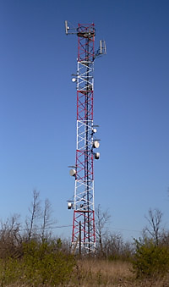
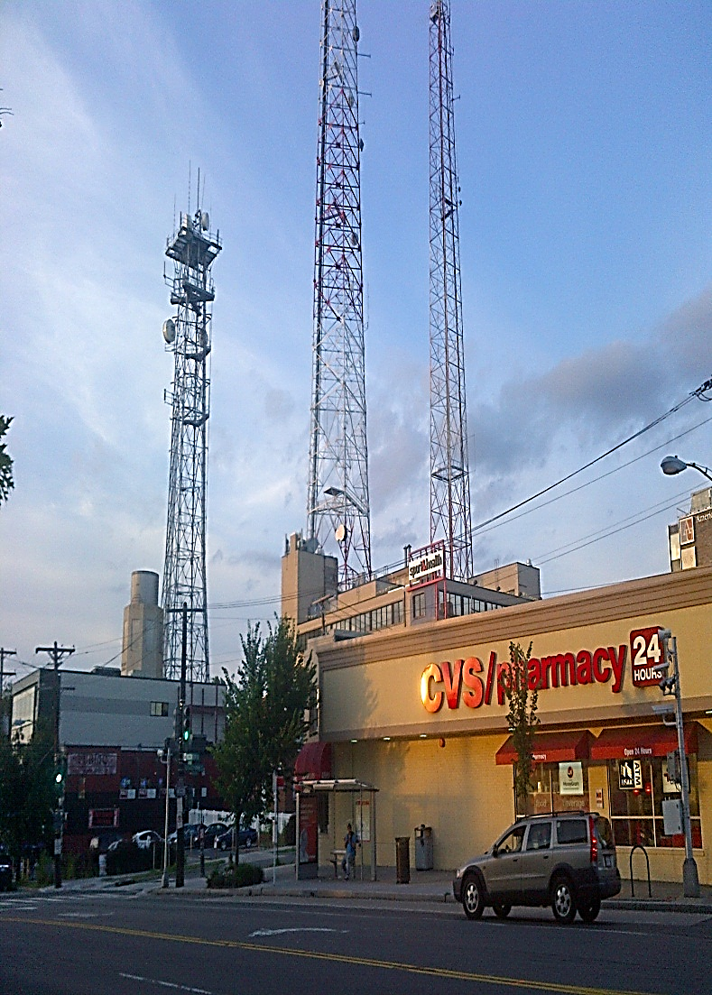
Macrocells

Slide 5
Rationale for Amending Collocation Agreement
While macrocell deployment still exists and will continue to exist, there are now a variety of complementary and alternative technologies that are far less obtrusive.
Distributed antenna system (DAS) networks and other small-cell systems use components that are a fraction of the size of macrocell deployments.
Antennas often placed on existing structures:
Power poles
Street lamps
Traffic signals
Existing buildings

Slide 6
Typical Facilities on Utility Poles

Slide 7
Rationale for Amending Collocation Agreement
Next generation (5G) Broadband services depend upon densification – strategic placement of hundreds of thousands of DAS and small cell systems, frequently placed close together to ensure each cell is shared by a small number of users.
Small facilities are being deployed on historic properties and in historic districts, and these deployments will continue.
Facilities can be deployed on utility poles, buildings, and other existing structures in or near historic districts to facilitate broadband—with little or no impact on historic properties.

Slide 8
French Quarter New Orleans

Slide 9
Original Collocation Agreement – Towers
Collocations on towers built before 2001 are largely excluded from Section 106 review.
Collocations on towers built after 2001 are largely excluded if the underlying tower went through Section 106 review.
Collocations on towers built after 2001 with no record of Section 106 compliance must be reviewed.

Slide 10
Original Collocation Agreement – Towers
Section 106 review of collocation on a tower is always required if:
Antenna will substantially increase the size of the tower;
Underlying tower adversely affected historic properties;
Underlying Tower subject to pending environmental review;
Complaint that the tower has an adverse effect.

Slide 11
Original Collocation Agreement – Buildings and Non-Tower Structures
Collocation on building/non-tower structure not subject to review unless the building or structure is:
Over 45 years old;
Inside historic district, or within 250 feet of historic district, and the antenna is visible from the ground level from within the historic district;
National Historic Landmark;
Listed or eligible for listing in National Register;
FCC has received a complaint about collocation alleging adverse effects.

Slide 12
Infrastructure Report and Order
In the October 2014 Infrastructure Report and Order, the Commission adopted two limited exclusions from Section 106 review.
The Commission stated that there is room for additional streamlining and directed staff to work with ACHP and other stakeholders to develop a program alternative.

Slide 13
Collocation Agreement Amendment
Collocation Agreement was amended on August 3, 2015.
Built upon two exclusions adopted in the October 2014 Infrastructure Report and Order.
Significantly expanded exclusions for buildings and structures that are not historic, regardless of age.
Adopted limited exclusions for buildings and structures that are historic or in or near historic districts.

Slide 14
Outside of Historic Districts and not Historic Properties
Exclusion for deployments on buildings and non-tower Structures, regardless of age (i.e., more than 45 years old), provided that:
Building or structure is not historic;
Building or structure not located in or near a historic district;
Deployment meets specified size limits;
Deployment causes no new ground disturbance;
Commission has not received a notice that collocation will have an adverse effect on a historic property.

Slide 15
Collocations on Historic Properties and in Historic Districts
Exclusion for collocation on building or non-tower structure that is a historic property or in or near historic district, provided that:
Property is not a National Historic Landmark;
Only one antenna on the building or structure that is no larger than 3 cubic feet;
Antenna is stealthed to complement building or structure;
No pre-existing antennas on building or structure;

Slide 16
Collocations on Historic Properties and in Historic Districts
Antenna’s associated equipment will not be visible from within the historic district or near the district;
No new ground disturbance; and
Deployment will not damage historic materials when it is installed or removed.

Slide 17
Collocations on Utility Structures in Historic Districts
Collocations on utility poles or electric transmission towers located inside or near a historic district are excluded, provided that:
Structure is not located on a National Historic Landmark;
Antenna does not exceed three cubic feet in volume, with a cumulative limit of 6 cubic feet if there is more than one antenna on the structure;
Antenna’s associated equipment on the structure does not cumulatively exceed 21 cubic feet in volume;
No new ground disturbance.

Slide 18
Collocations on Lighting Structures in Historic Districts
Collocations on a traffic light, light pole, lamp post, or other structure whose primary purpose is to provide public lighting that is located inside or near a historic district may be excluded, provided that:
Antenna meets specified size limits;
No new ground disturbance;
Provider finds that the structure is not a contributing or compatible element within the historic district, and SHPO concurs with this determination under a process in the agreement.
[Note: This exclusion has not yet taken effect because it needs approval from the Office of Management and Budget under the Paperwork Reduction Act.]

Slide 19
Collocations – Interior of Buildings
Small antennas mounted in the interior of a building that is not a National Historic Landmark, or listed in or eligible for listing in the National Register, are generally excluded from review, regardless of the building’s age or the antenna’s size, even if the building is located in a historic district.
A small antenna mounted in the interior of a building that is listed in or eligible for listing in the National Register may be excluded from historic preservation review provided that it is not a National Historic Landmark and the deployment meets strict visibility limits.
Installations in and on historic buildings must be completed in a way that does not damage historic materials, and permits removal without damaging historic materials.

Slide 20
Replacement of Facilities on Historic Properties or in Historic Districts
Replacement of existing antennas on historic buildings or structures or near a historic districts are generally excluded from review, provided:
The replacement does not exceed the greater of:
The size of the original antenna enclosure and associated equipment; or
Specified volume limits.
Deployment meets restrictions on new ground disturbance.

Slide 21
First Amendment to the Nationwide Programmatic Agreement for the Collocation of Wireless Antennas
QUESTIONS?

