Slide 1
DAS/Small Cell and Rights-of-Way
Jill A. Springer
Deputy Federal Preservation Officer, FCC

Slide 2
Deployments in Rights-of-Way (ROW)
The 2016 Collocation Amendment introduced many efficiencies beneficial to DAS and small cell deployments.
The NPRM seeks input on further improvements specifically targeted to new (and anticipated) technology.
Such deployments are frequently proposed in established ROW.

Slide 3
Deployments in Rights-of-Way (ROW)
The NPA exclusions apply in actively used ROWs specifically designated for the location of communications towers or above-ground utility transmission or distribution lines and associated structures and equipment.
The 2015 Collocation Amendment, the NPA, and the 2014 Infrastructure Report and Order may be relevant to determining the environmental review requirements for projects proposed in ROW.
When in doubt, consult FCC staff about your specific project.

Slide 4
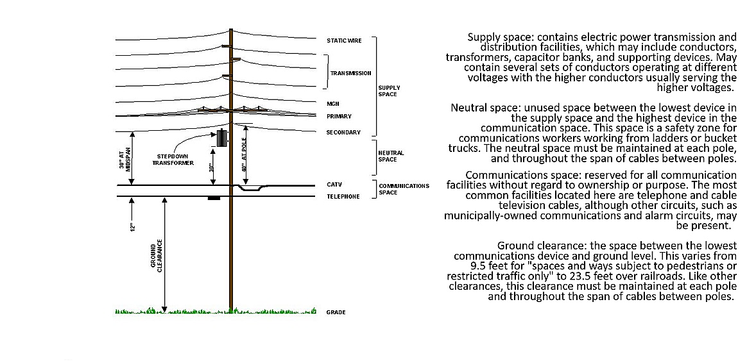

Slide 5
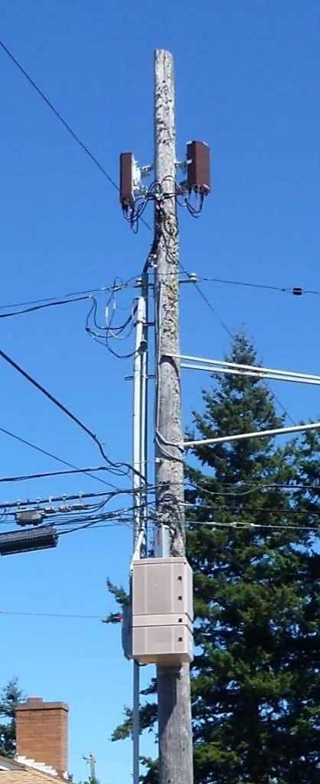
Wooden Electric Distribution Poles
Small Cell deployment on wooden utility pole with two antennas above the communications space, cabinet below the communications space connected to mobile communications network core with fiber-optic cable.

Slide 6
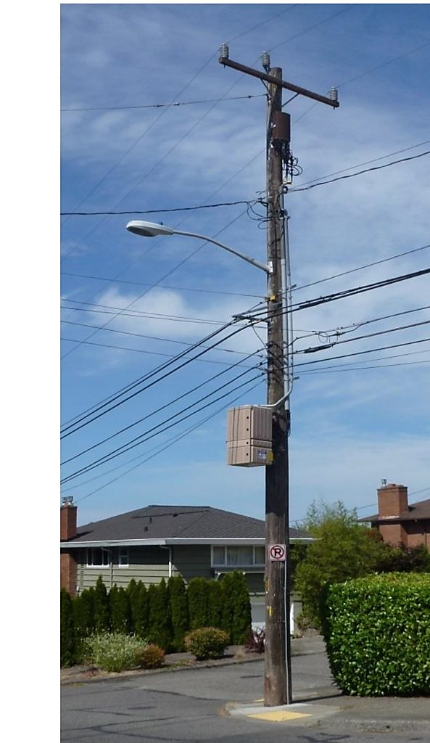
Wooden Electric Distribution Poles
Small Cell deployment on wooden utility pole with antenna below the high voltage lines.

Slide 7
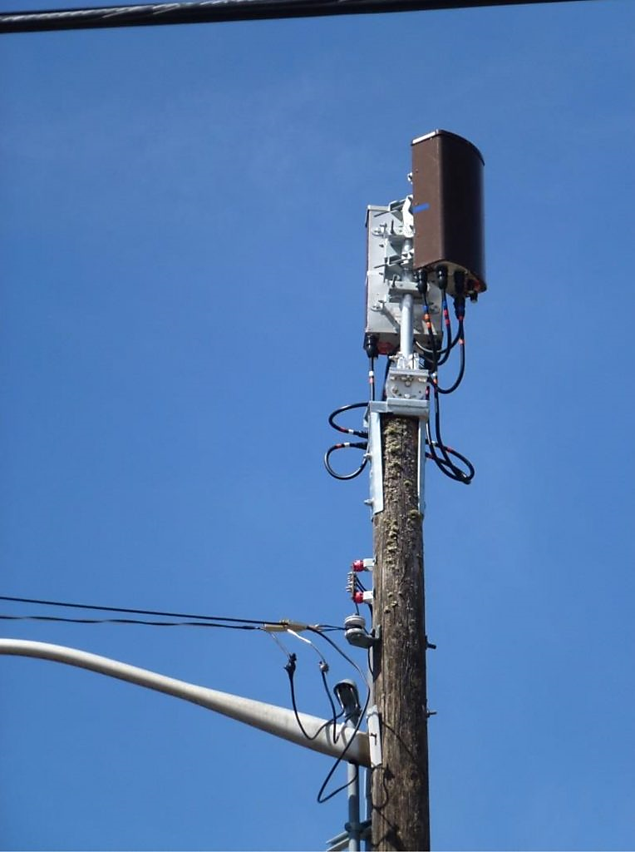
Wooden Electric Distribution Poles
Pole extensions are sometimes used to add antennas. Wooden poles may rot at the top first, requiring companies to replace older poles with taller ones to fit small cells.

Slide 8
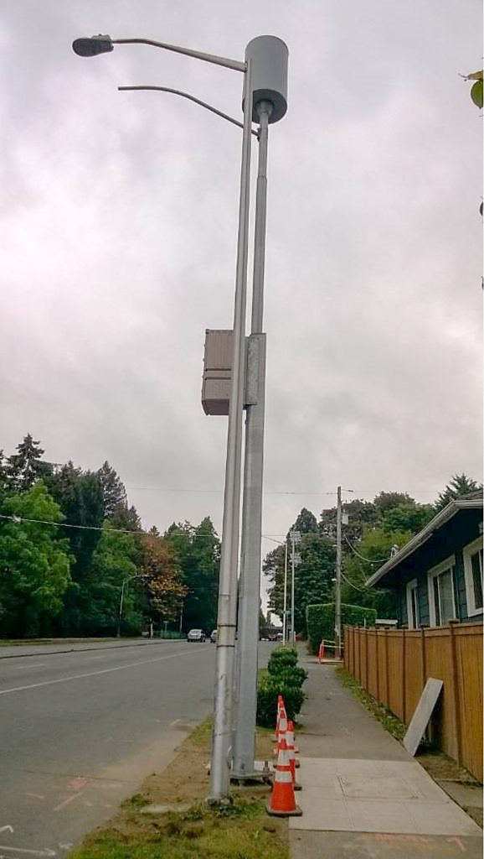
Hybrid Street Light Poles
Hybrid street lights can be designed with antennas.
Require ROW permits.
Power must be separated from the communications connection.
Fiber optic cable underground.

Slide 9
NEPA Requirements in Utility and Communications ROW
FCC’s 2014 Report and Order III.B.3 found that “certain wireless facilities deployed in above-ground utility and communications rights-of-way…will not individually or cumulatively have a significant effect on the environment.”
The construction of wireless facilities in ROW designated and actively used by a Federal, State, local, or Tribal government for communications towers, above-ground utility transmission or distribution lines or any associated structures and equipment is categorically excluded from NEPA review if the wireless facilities meet size/volume limits and ground disturbance restrictions, as well as additional criteria outlined in Section 1.1306(c).

Slide 10
NEPA Requirements in Utility and Communications ROW
Accordingly, the preparation of an Environmental Assessment for DAS/Small Cell deployments in ROW, including those on new or replacement poles, would generally not be required unless the proposed installation may affect historic properties protected by Section 106 or if the proposed installation would result in human exposure to RF emissions in excess of health and safety guidelines cited in Section 1.1307(b).

Slide 11
NHPA Requirements in Utility and Communications ROW
NEW POLES FOR COMMUNICATION USE:
NPA Section IIIE excludes from SHPO review the construction of a facility (tower or antenna) in or within 50’ of the outer boundary of a right-of-way designated by a Federal, State, local, or Tribal government for the location of communications towers or above-ground utility transmission or distribution lines and associated structures and equipment and in active use for such purposes, provided the facilities meet size criteria and are not located within the boundaries of a Historic Property.
Such new facilities still require full TCNS processing and Tribal participation.

Slide 12
NHPA Requirements in Utility and Communications ROW
DEPLOYMENTS ON EXISTING UTILITY OR COMMUNICATION POLES:
The 2016 Collocation Amendment establishes that most proposed collocations (including associated equipment included in the definition of antenna in Stipulation I.A) may be mounted on existing buildings and non-tower structures without being reviewed through the Section 106 process (SHPO and TCNS process) provided they meet certain criteria identified in Stipulations V, VI and VII of the Amendment.
This includes deployments on utility poles and electric transmission towers that meet criteria established in Stipulation VII B, but does not include traffic control or public lighting structures inside or within 250’ of historic districts which are subject to the process established in Stipulation VII C.

Slide 13
NHPA Requirements in Utility and Communications ROW
REPLACEMENT OF EXISTING UTILITY OR COMMUNICATION POLES:
DAS/Small Cell deployments planned in conjunction with a routine pole replacement anticipated and undertaken by the utility provider or pole owner with no expansion of ground disturbance and no substantial increase in size (as defined in Collocation Agreement) are not generally subject to FCC NEPA or Section 106 reviews. Contact FCC staff to confirm whether Tribal outreach is required and for guidance on replacements in historic districts.
If the deployment of the DAS/Small Cell equipment will require a substantially larger (taller or wider) utility or communications pole, or if the new pole requires a new or expanded area of ground disturbance, contact FCC staff for guidance.

